Slide 1
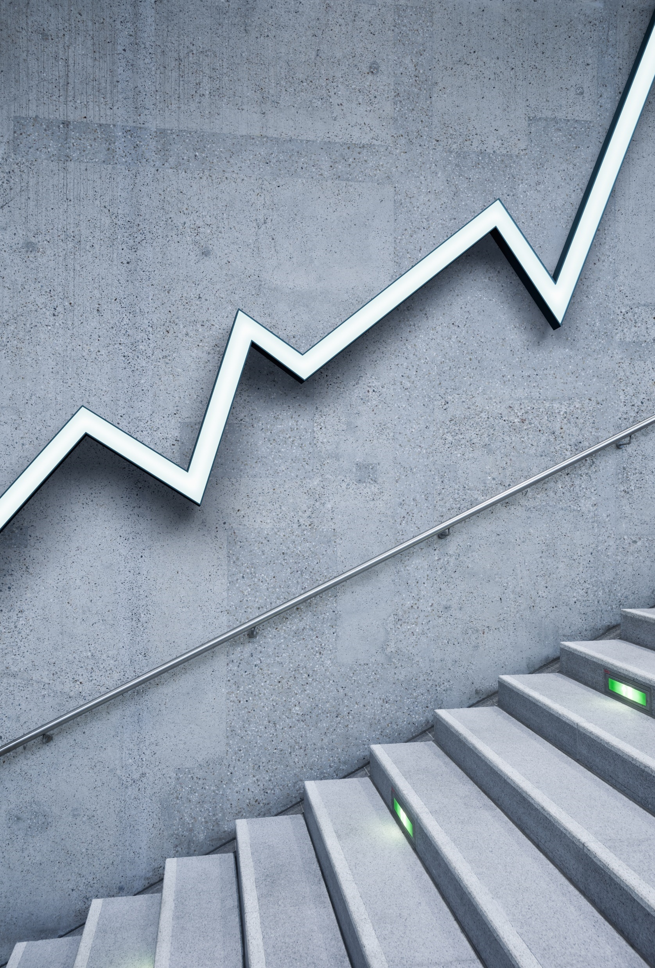
Budweiser EDA & Initial Analytics Report Out #1
Brewtastic Analytics LLC
February 2021

Slide 2
YouTube Presentation
Find a video recording of the presentation at the link below:
https://www.youtube.com/watch?v=psiWavyPYo4

Slide 3
Project Description & Deliverables
Project Description: Brewtastic Analytics Inc was engaged by Anheuser-Busch InBev (Budweiser - NYSE: BUD) to study and provide a catalog of relevant statistics & further insights concerning general brewery and craft beer style trends across the United States.
The client requested these specific questions below to be addressed, along with any other material trends identified by Brewtastic:
1) How many breweries are present in each state?
2) What are the median ABV (Alcohol By Volume) and IBU (international Bitterness Units) for each state?
3) Which state has the maximum ABV? Which state has the most bitter beer?
4) Is there any apparent relationship between bitterness and alcoholic content?

Slide 4
Data Sources & Quality Control
Sources:
1) The US craft beer (‘Beers.csv’) and US breweries (‘Breweries.csv’) datasets were provided by the client.
2) Data for 2020 annual total consumption of beer per state and per capita by state were sourced from World Population Review which can be found at https://worldpopulationreview.com/state-rankings/alcohol-consumption-by-state
Data Quality Control:
Beers.csv - Total rows: 2410
ABV: 62 nulls
IBU: 1005 nulls (52 entries not included in the analysis)
Missing values were populated with median or mean values from it’s given beer style population.
There were 52 entries with no IBU information/statistics for their specific style and were not included in the analysis.

Slide 5
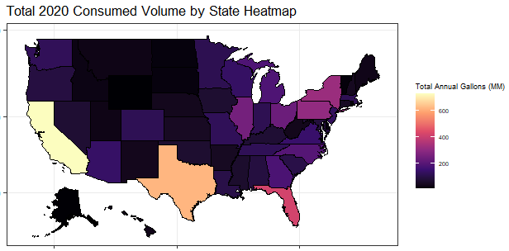
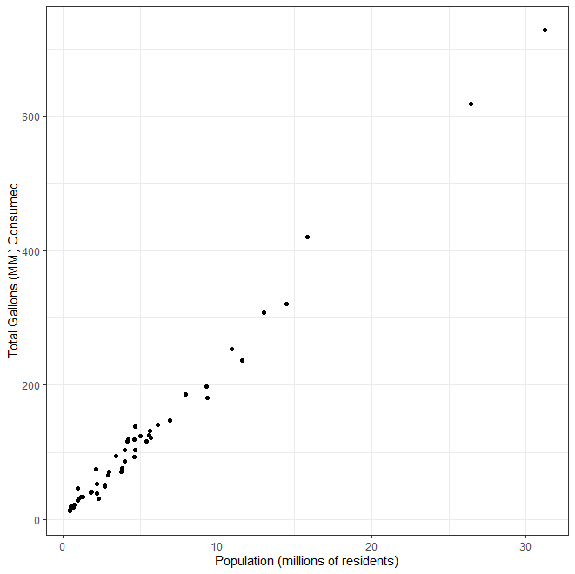
EDA Visualization #1 State Population & Consumption
- Neil Armstrong
Visualizations
A
Heatmap of the total 2020 annual consumption of beer (millions of gallons) by state)
Scatter plot showing state resident populations vs total 2020 annual consumption of beer (mm gal)
Note population refers to only those resident over the age of 18
B
Observations
Strong positive correlations between a state’s annual consumption and it’s population of residents
As is typical when considering gross population data, the large contrast between the most vs least densely populated states that subtle trends are difficult to extract. The analysis which follows generally relies on per capita trends, though these derivatives can be skewed/inflated for the states with the smaller populations.

Slide 6
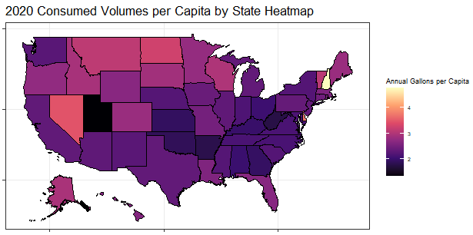
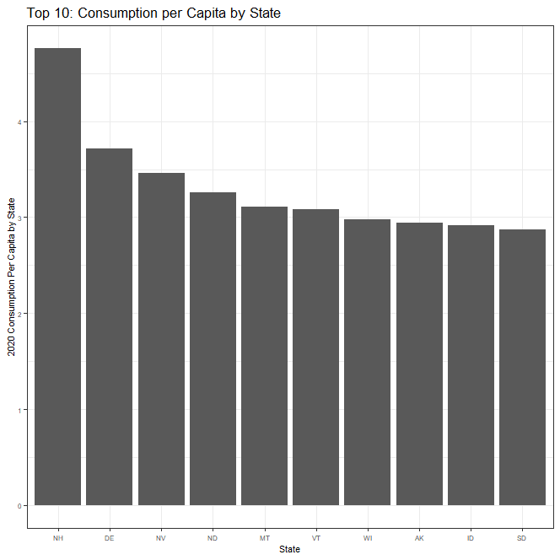
EDA Visualization #2 State Consumption per Capita
Visualizations
A
Heatmap of the total 2020 annual consumption of beer per capita (gallons per resident)
Histogram of the top 10 with the most per capita consumption
Observations
The top 10 per capita consumers all tend towards the sparser populated states
New Hampshire stands far above the other states while the other 9 of the top 10 show smaller contrasts
Per capita consumption generally increases west of the Mississippi River (notable exceptions New Hampshire, Vermont)
B
Note
Histogram showing all 50 states is included in the appendix

Slide 7
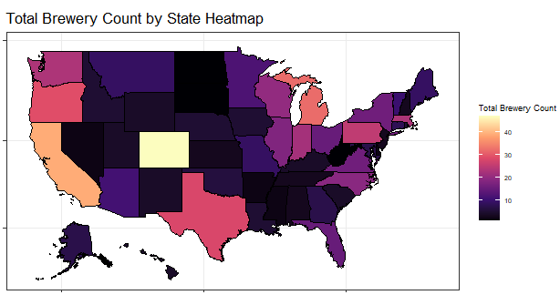
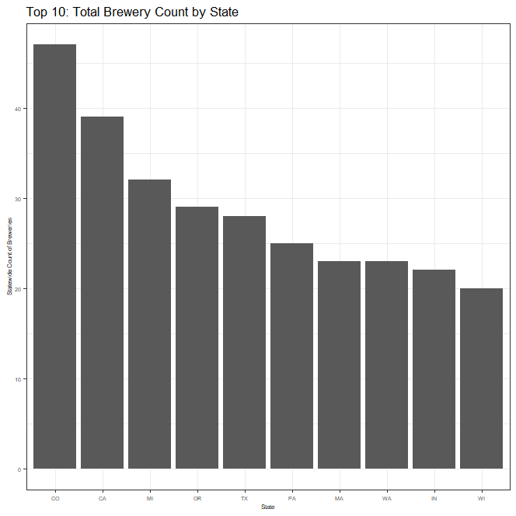
EDA Visualization #3 Total Brewery Count by State
Visualizations
A
Heatmap of brewery count by state
Histogram of the top 10 states with the greatest number of breweries
Observations
Generally, the more populated states tend to possess more breweries
Continental interior, apart from the Great Lakes region & Colorado, tend to have low brewery counts
B
Note
Histogram showing all 50 states is included in the appendix

Slide 8
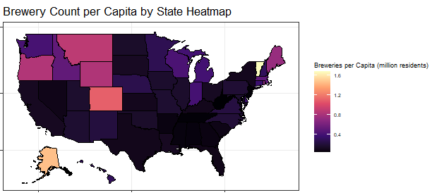
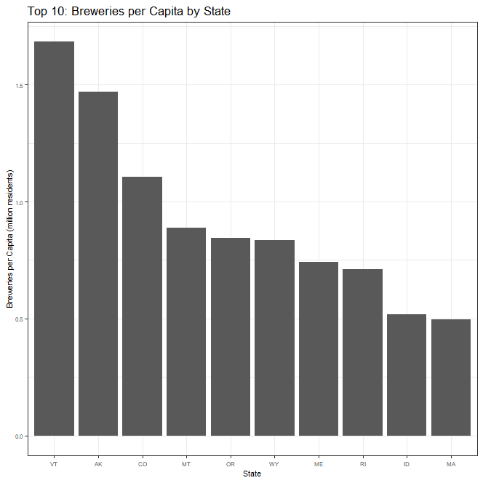
EDA Visualization #4 Count of Breweries per Capita by State
Visualizations
A
Heatmap of the count of breweries per capita (millions of residents) by state
Histogram of the top 10 states with the greatest number of breweries per capita
Observations
Generally, the northwest region (including Colorado) dominates the top 10 followed by the most northeasterly region
Alaska’s high rank likely a function of it’s sparse population and the logistical challenges to transport large volumes from brewers in the lower 48 states
B
Note
Histogram showing all 50 states is included in the appendix

Slide 9
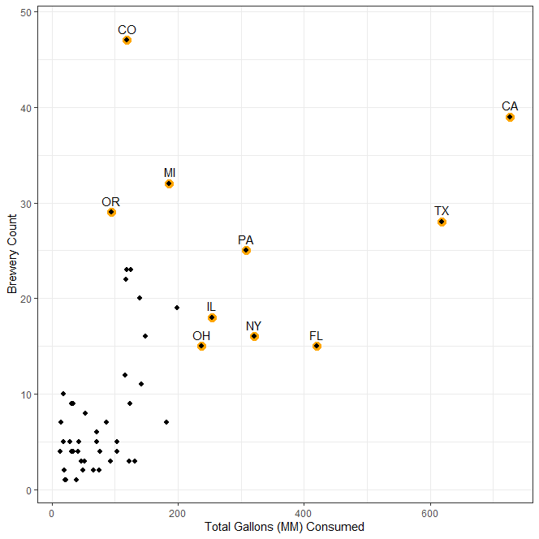
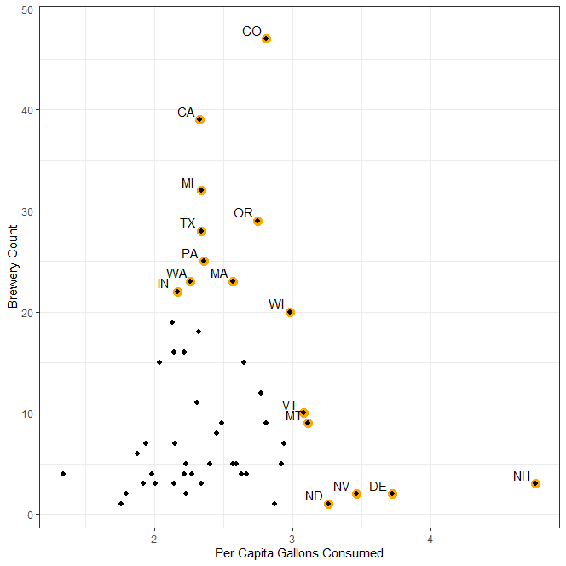
EDA Visualization #5 Breweries & Consumption
A
Visualizations
Scatterplot showing 2020 total gallons consumed versus total brewery count by state
Scatterplot showing 2020 consumption per capita versus total brewery count by state
Outliers highlighted in yellow and labeled with their state abbreviations
Observations
General positive correlation between variables though we see significant divergence at the extremes
A population of high consuming states which may be underserved by local breweries are highlighted in the dotted red ellipse – interesting potential business development opportunities.
Other large per capita consuming states, which appear to also be underserved by local breweries are highlighted in dotted blue ellipse. These also may present modest development opportunities but, due to sparser population densities, won’t offer the advantages of scale.
B

Slide 10
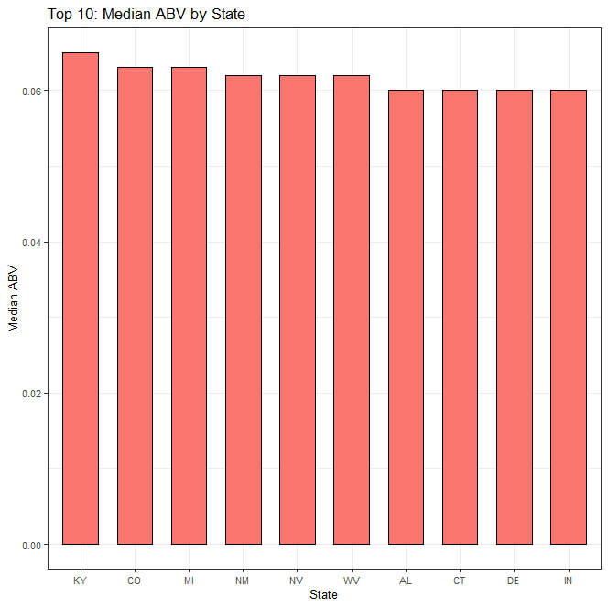
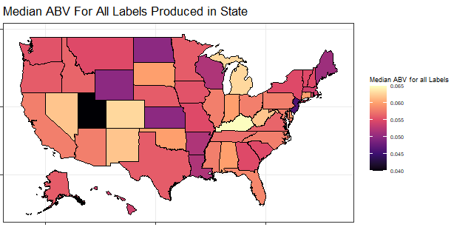
EDA Visualization #6 Median Alcohol by Volume (ABV)
Visualizations
Histogram showing the top 10 states with the highest median ABV for all labels which are produced by breweries in their state
Observations
Top 10 largely comprised of states which do not stand out in the earlier consumption & brewery visualizations (exceptions CO, MI).
Strict state laws concerning alcohol content are known to exist and vary state-to-state which may explain lack of variance within the top 10.
Note
Histogram showing all 50 states is included in the appendix

Slide 11
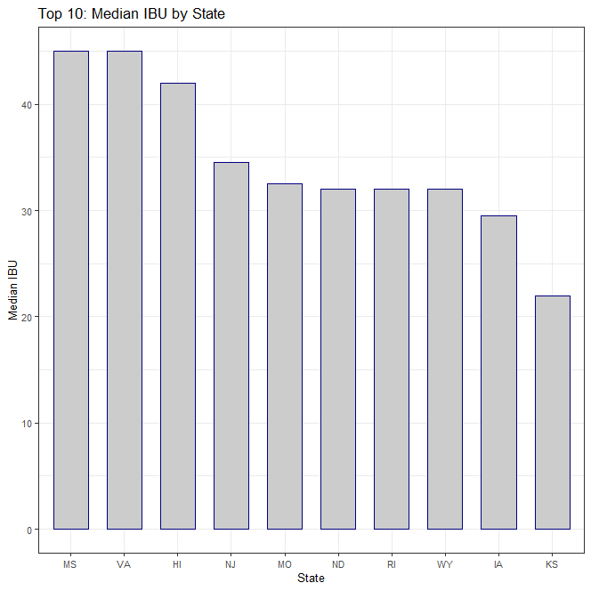
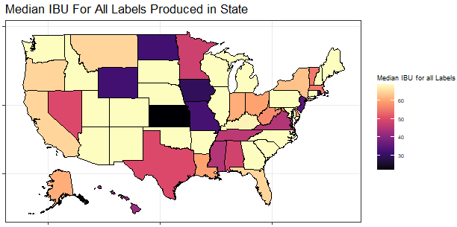
EDA Visualization #7 Median International Bitterness Unit Score (IBU)
Visualizations
Histogram showing the top 10 states with the highest median IBU for all labels which are produced by breweries in their state
Observations
Top 10 largely comprised of states which do not stand out in the earlier consumption & brewery visualizations.
As there are likely not many regulations concerning bitterness, we see much more variability across the top 10 and total population.
Note
Histogram showing all 50 states is included in the appendix

Slide 12
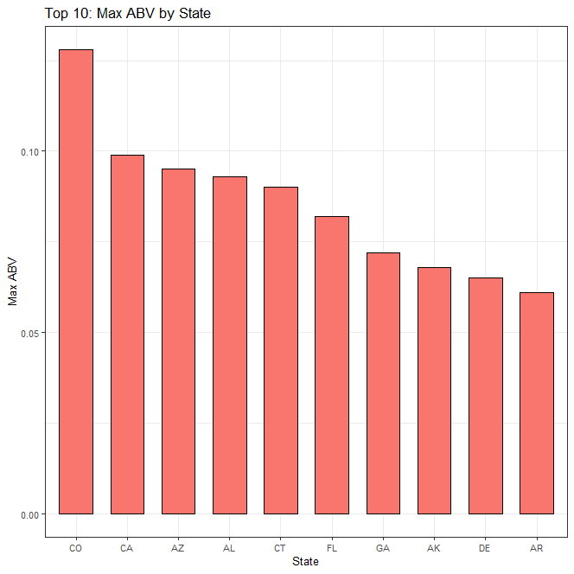
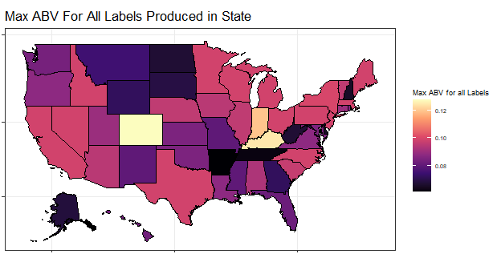
EDA Visualization #8 Maximum Alcohol by Volume (ABV)
Visualizations
Histogram showing the top 10 states with the highest maximum ABV for any label produced by a brewery in their state
Observations
Laws and regulations likely introduce much noise to these data. Many states impose upper limits on the ABV for which a beer can possess, so breweries may utilize names for higher alcohol content labels to get around (ie“barley wine”).
Perhaps this is best interpreted as identifying the states with the least strict ABV regulations
Note
Histogram showing all 50 states is included in the appendix

Slide 13
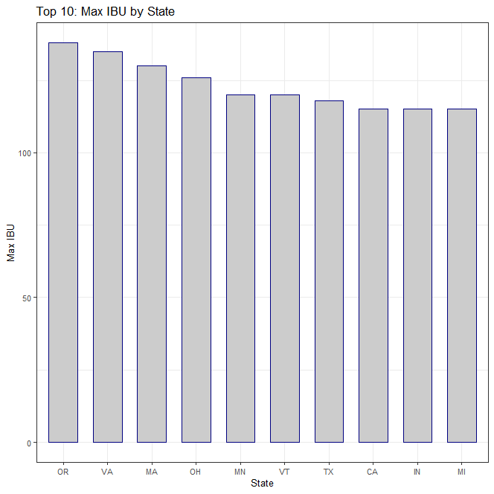
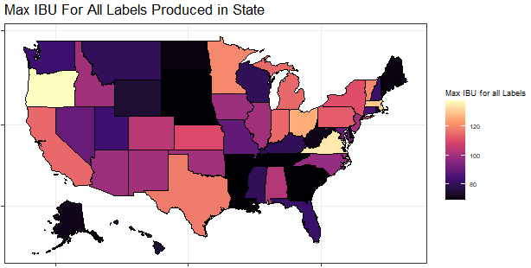
EDA Visualization #9 Maximum International Bitterness Unit Score (IBU)
Visualizations
Histogram showing the top 10 states with the highest maximum IBU for any label produced by a brewery in their state
Observations
Note
Histogram showing all 50 states is included in the appendix

Slide 14
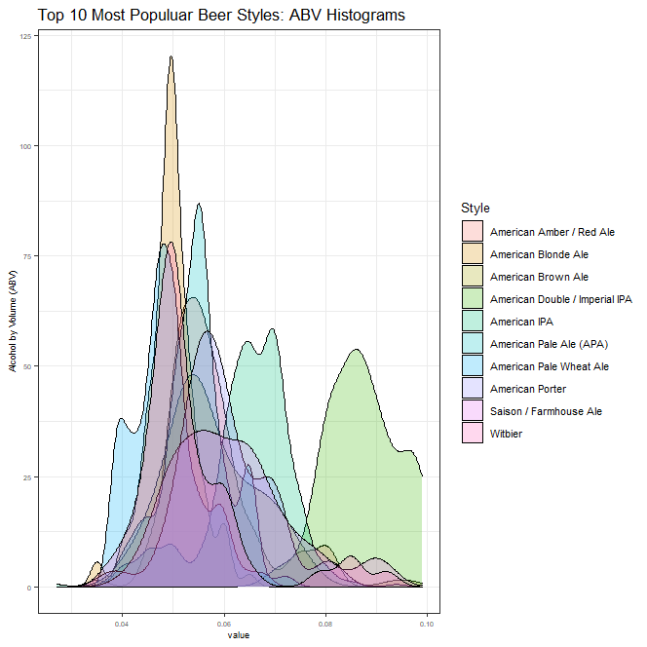
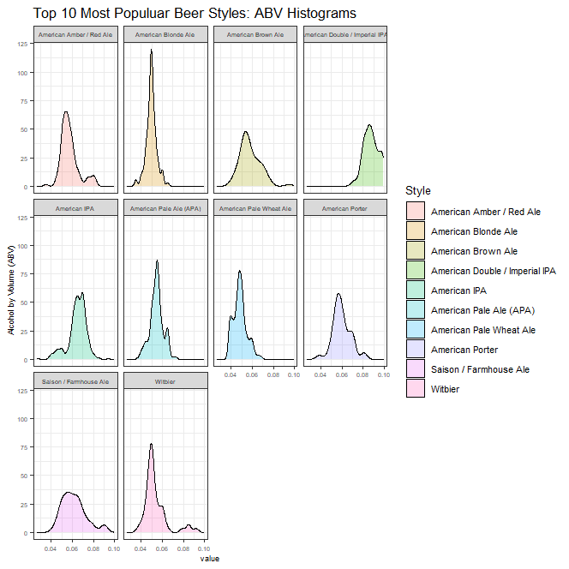
EDA Visualization #10 ABV Distributions by Popular Beer Styles
A
B
Visualizations
Observations
Density distributions for ABV by beer style, for all breweries, co-plotted to evaluate relationship between peaks for top 10 most popular styles
Density distributions for ABV by beer styles plotted independently to visualize specific distribution shapes
Generally, ABV distributions appear to be normally distributed for each beer type but standard deviations change.
Median ABV’s do vary but most fall within the range 0.045 to 0.055.

Slide 15
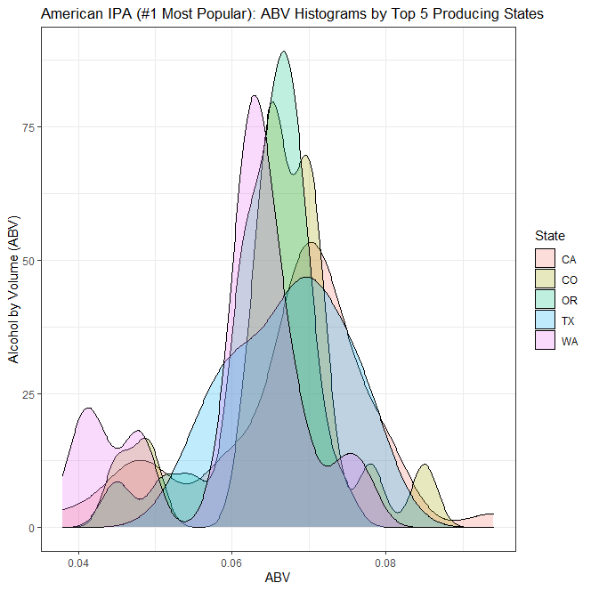
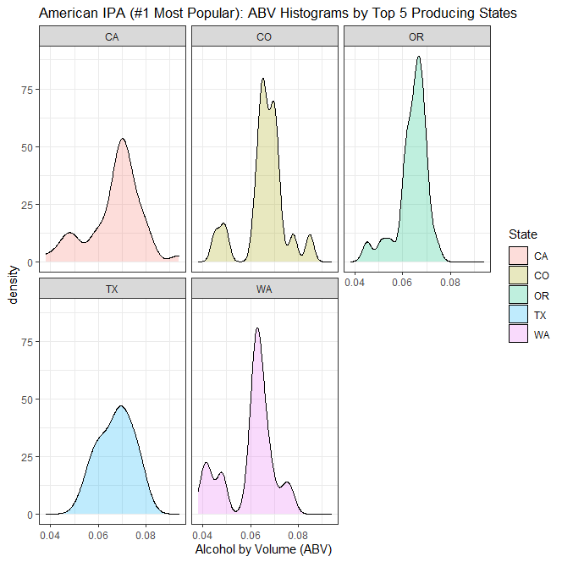
EDA Visualization #11 American IPA ABV Distributions by Top Producing States
Visualizations
Observations
Density distributions co-plotted for ABV for American IPA’s by the top 5 producing states (count of unique labels)
Density distributions independently plotted for ABV for American IPA’s only by state
Some states may show bi-modal distributions – further investigation recommended.
Median ABV’s vary but fall within the range 0.05 to 0.075 but standard deviations appear to be similar between states.

Slide 16
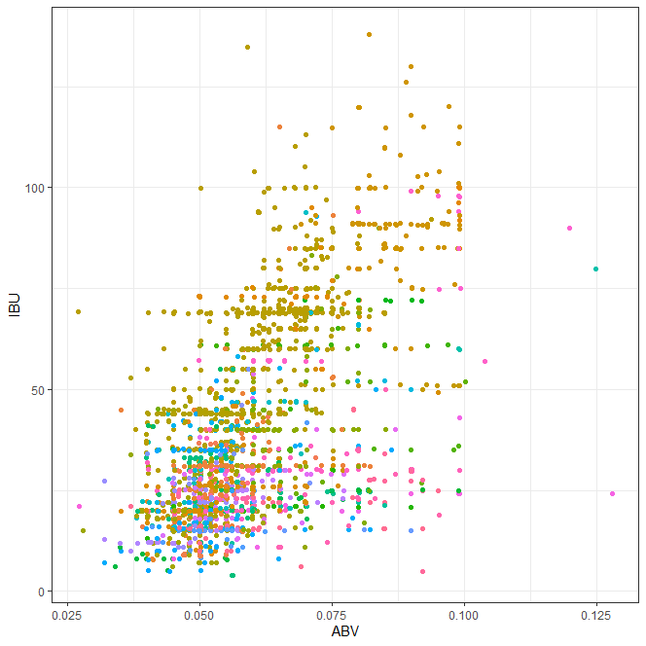
EDA Visualization #11 ABV & IBU Relationship for All Styles
Visualizations
Scatterplot showing ABV vs IBU for entire dataset colored by beer style. Note legend purposefully not included for aesthetic considerations – will be discussed later in presentation.
Some artifacts (striping) apparent from the strategy used to fill in missing data, mainly IBU’s (see blue arrows as examples of worst offenders).
Observations
Strong positive relationship between ABV and IBU for all beer styles.
Generally high variance across all ranges with some quite exceptional outliers.

Slide 17
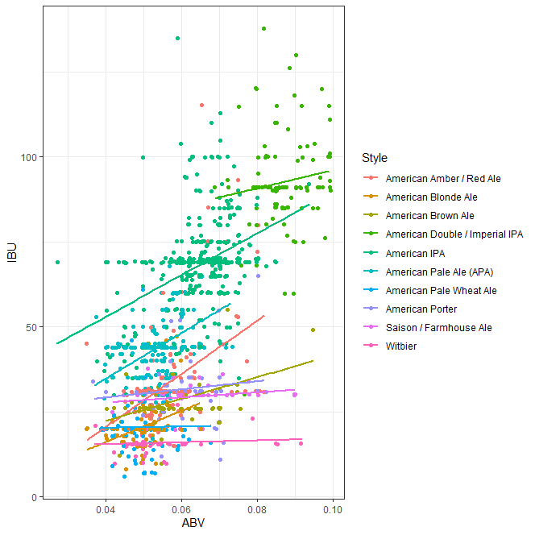
EDA Visualization #12 ABV & IBU Relationships for Ale’s
Visualizations
Scatterplot showing ABV vs IBU now only considering ‘Ale’ beer styles. Points colored by specific beer style.
Simple, best-fit linear models plotted for each specific beer style.
Striping artifacts are again apparent and do influence the linear models (see blue arrows for examples). These calculated trends should be used as a general guide at best.
Observations
Generally positive relationship between ABV and IBU for all ‘Ale’ beer styles though each style likely possess its own unique relationship. Some styles do not show much contrast in IBU’s but do have wide range of ABV’s (ex Witbier, Saison, Porter…)
Visually obvious that significant variances exist for all styles but difficult to quantify due to artifact effects.

Slide 18
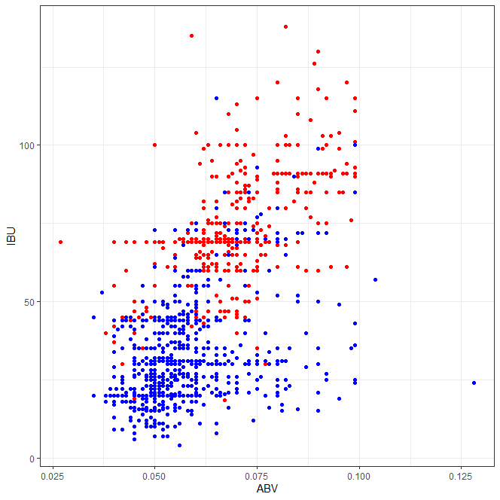
Classification Model Strategy Preview IPA vs Other Ale Training Dataset
- IPA
Description
- Other Ale’s
A classification model to determine Ale types (IPA vs Other Ale’s) is under development which will output best-guess Ale styles, and associated probabilities, for entries which only supply ABV and IBU information. K-NN classification strategy will be employed.
The scatterplot shows the ABV and IBU values for the training set colored by Ale type.
We have elected to keep the obvious artifacts in the training set but further analysis could explore the model performance with those removed.
Observations
Overall, strong positive relationship between ABV & IBU is apparent.
Encouraging segregation between the Ale styles lends optimism that k-NN will be an effective tool for classification

Slide 19
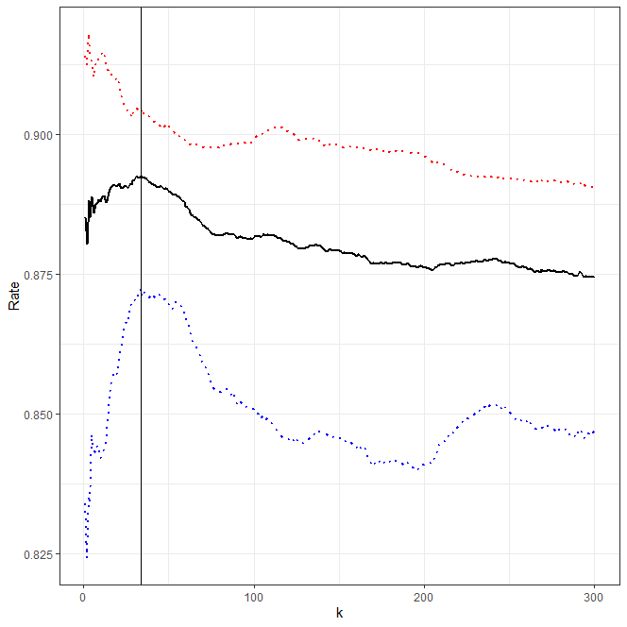

Classification Model Strategy Preview 70/30 (train/test) k sensitivity analysis
Description
k = 34 ($\sqrt{n)}$
Optimal “k” sensitivity analysis has been performed using a 70% train / 30% test scheme.
Obvious choice of k = 34, which happens to be the square-root of the sample size of the training dataset, will yield the most accurate results.
This optimal “k” will be employed for the preferred model.
Specificity
Accuracy
Sensitivity

Slide 20
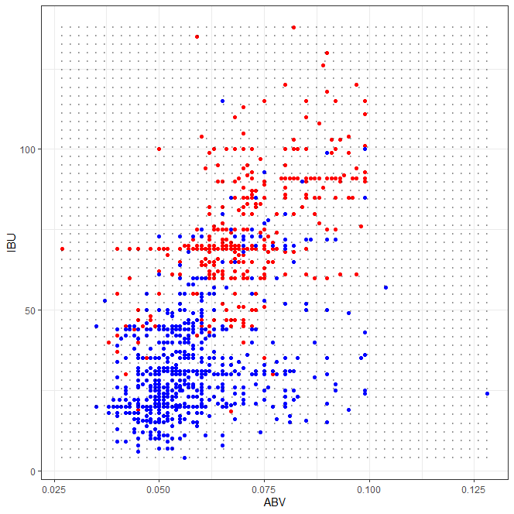
Classification Model Strategy Preview Synthetic Grid Construction
- IPA
Description
- Other Ale’s
A synthetic, evenly-spaced set of nodes (ie grid) was constructed for different ABV & IBU pair combinations.
Each point was input to the k-NN model and a best-guess classification (IPA or Other Ale) was recorded, along with the probabilities for each class given a k = 34.
- Grid Node

Slide 21
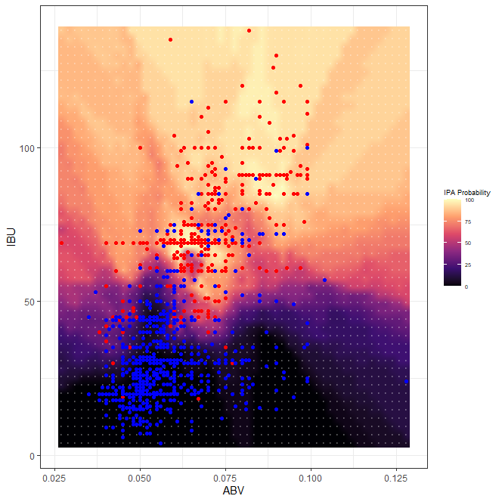
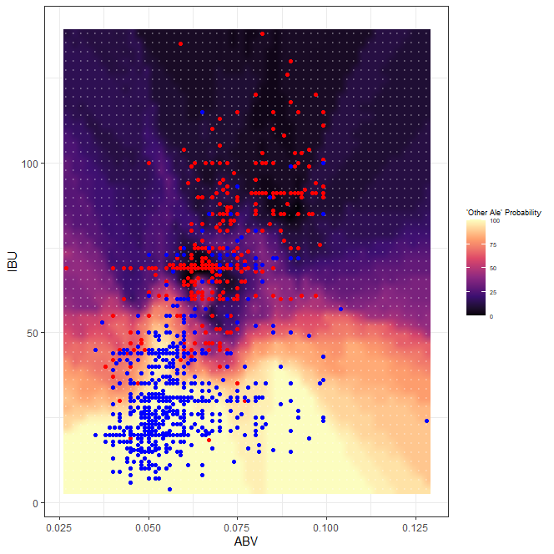
Classification Model Strategy Preview Interpolated Probability Models
India Pale Ale Probability Heatmap
‘Other’ Ale Probability Heatmap
- IPA
- Other Ale’s
- Grid Node
Visualizations
Observations
Using the probabilities calculated for each grid node, interpolated heatmap models were generated for both IPA and Other Ale styles.
These models can be directly referenced by the client to test any point(s) for which ABV & IBU’s are available.
Probabilities greater than 50% for a given Ale style will be the best-guess output from the k-NN model but it’s important that the users understand which zones have the highest and lowest confidences.

Slide 22
Appendix

Slide 23
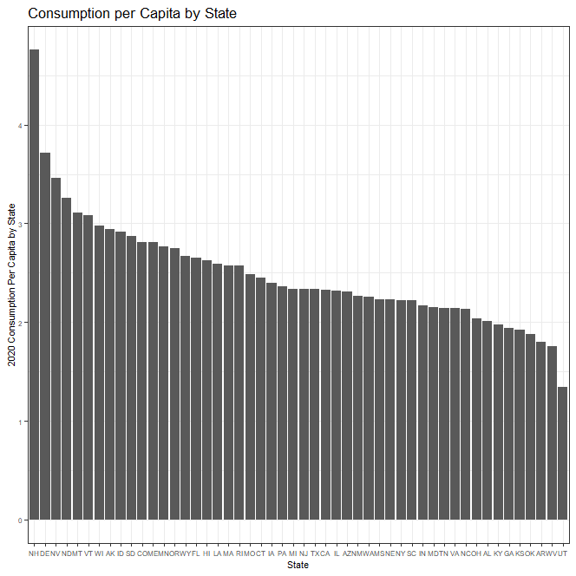
EDA Visualization Per Capita Consumption by State – All 50 States

Slide 24
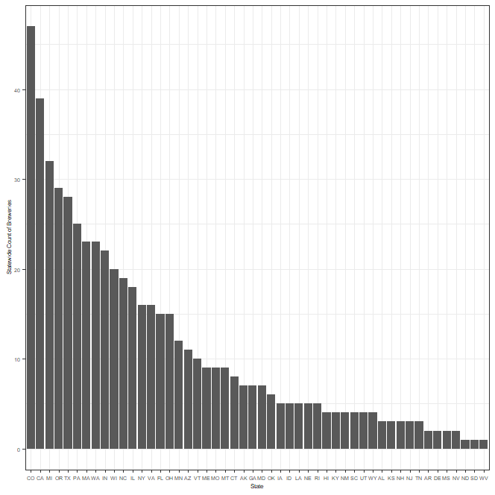
EDA Visualization State Brewery Count – All 50 States

Slide 25
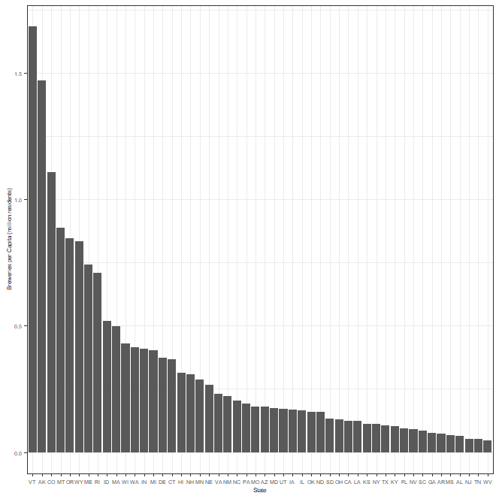
EDA Visualization Brewery Count per Capita – All 50 States

Slide 26
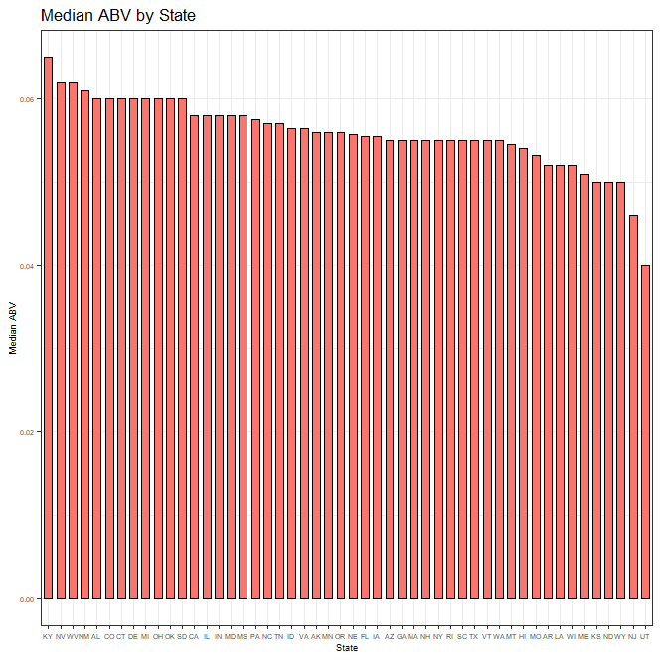
EDA Visualization Median ABV by State– All 50 States

Slide 27
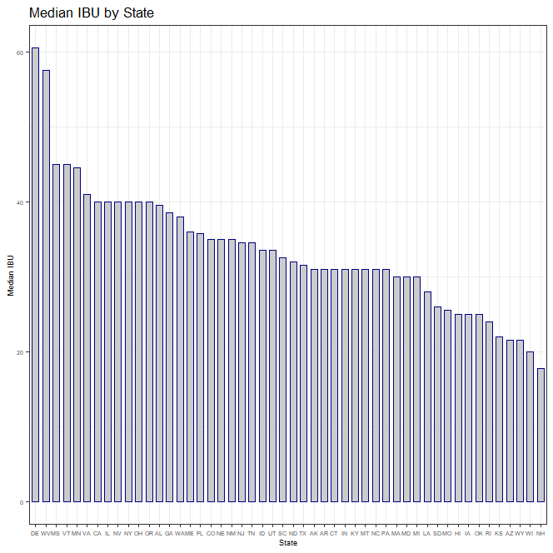
EDA Visualization Median IBU by State – All 50 States

Slide 28
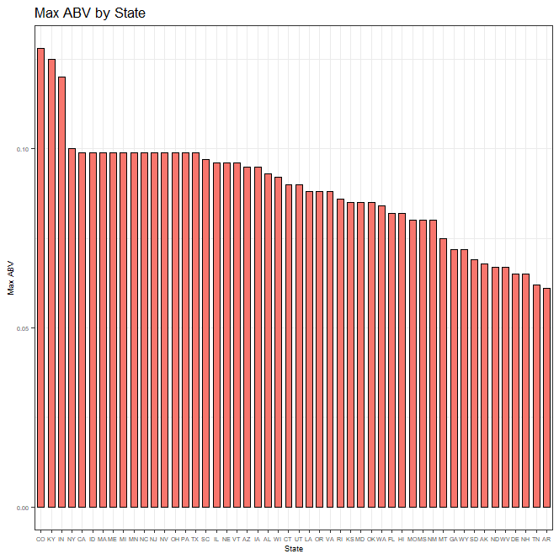
EDA Visualization Max ABV by State – All 50 States

Slide 29
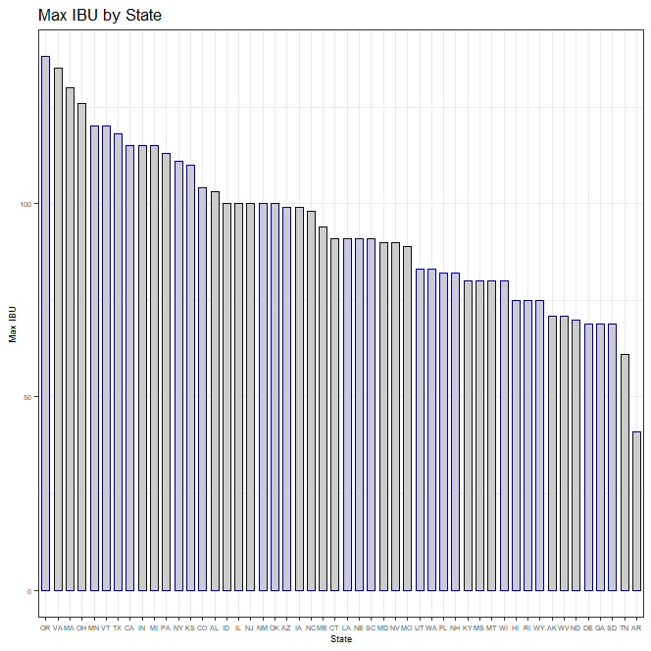
EDA Visualization Max IBU by State – All 50 States

